Slide 1

A Report of Analysing COVID-19 data for India
at
Wipro Limited
Submitted by
THOLISAPURAM SHAIK NASIR HUSSAIN
SNEHA PORWAL
RIDDHI CHATTERJEE
in partial fulfillment for the award of the internship
In
DATA ANALYTICS AND ARTIFICIAL INTELLIGENCE-INFORMATION MANAGEMENT (DAAI-IM) (GROUP - 11)

Slide 2
Internship Report
Team Members
Riddhi Chatterjee
Sneha Porwal
Tholisapuram Shaik Nasir Hussain
Mentor Name
Ramchandra Sekhar

Slide 3
Business Problem:
In the current pandemic situation where COVID-19 has spread across the world impacting 150+ countries, India too is severely impacted: 34 states / UT affected. First Case Reported on: 30 January 2020 as of 10th June, Ministry of Health and Family Welfare reported a total of 276,804 cases, 134,843 recoveries and 7,751 deaths the infection rate of COVID-19 in India is: 1.7 (significantly lower than in the worst affected countries.

Slide 4
Business Objective:
To analyse the covid-19 India data and find key insights on patient demographics, patient clusters, state and district level spread. To be able to foresee the local transmission rate, top affected districts and predict the saturation point of the disease spread.

Slide 5
Problem Statement
1) Data preparation: Loading into Hadoop
Quality data preparation
Identifying tool for BI
2) Identifies the top 6 affected districts in India Improves planning and strategy to provide.
3) Identifies patient demographics to understand the spread and trend in daily cases treatment.

Slide 6
4) Provides key insights for new policy formation like lockdown extension.
5)Predicts the saturation point for the spread.
6)Average time taken by patients to recover, average time a patient stays in hospital-hospital occupancy.
7)To track load on healthcare facility and predict number of ventilators required in future.

Slide 7
Dataset Description:
In this use case, there are 3 data sets:
1. Qsecond.csv
2 .Nation.csv
3.Recover.csv

Slide 8
Process
1) Create a Database
2) Creating And Loading data for Qsecond.csv
3)Creating And Loading data for Nation.csv
4)Creating And Loading data for Recover.csv

Slide 9
Statement 2 Query
select * from second
sort by confirmed desc limit 6;

Slide 10
Statement 3 Query
Select a.Daily_Confirmed from third a join (select max(Daily_Confirmed ) as max_Daily_Confirmed from third) b on a.Daily_Confirmed = b.max_Daily_Confirmed;

Slide 11
Statement 6 Query
Select avg(avg_time_for_recovery)
from sixth;
Select avg(avg_time_in_hospital)
from sixth;

Slide 12
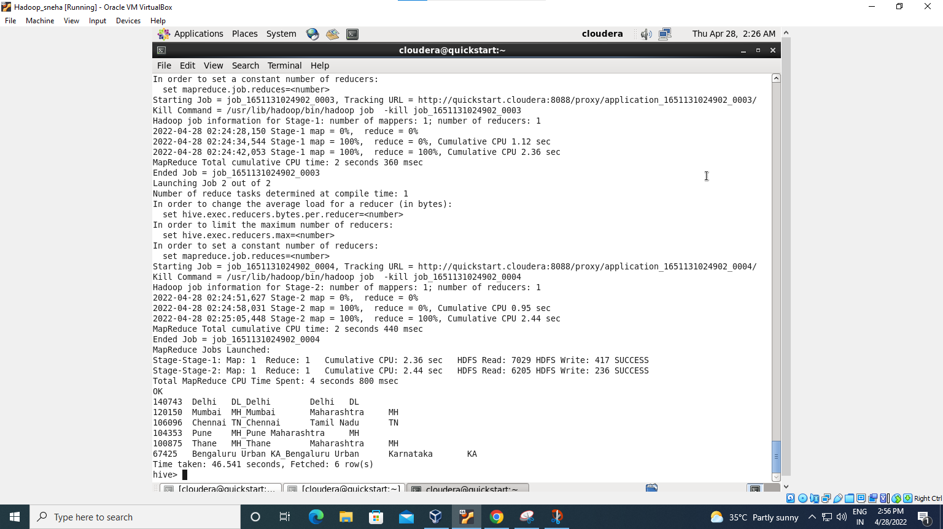
Output of Second Problem

Slide 13
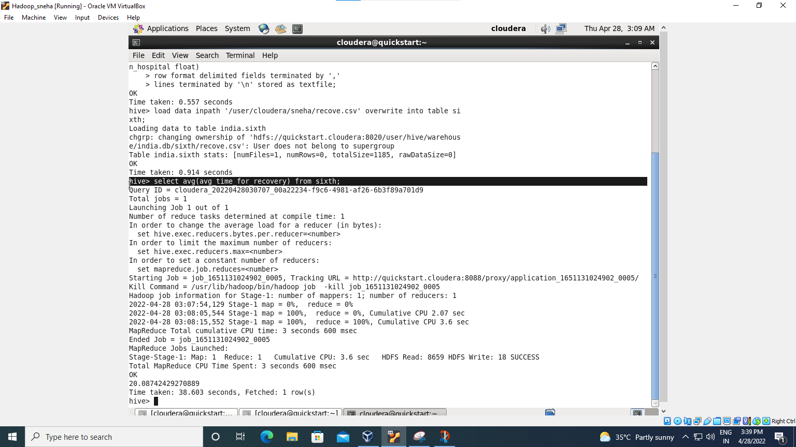
Output of Sixth Problem

Slide 14
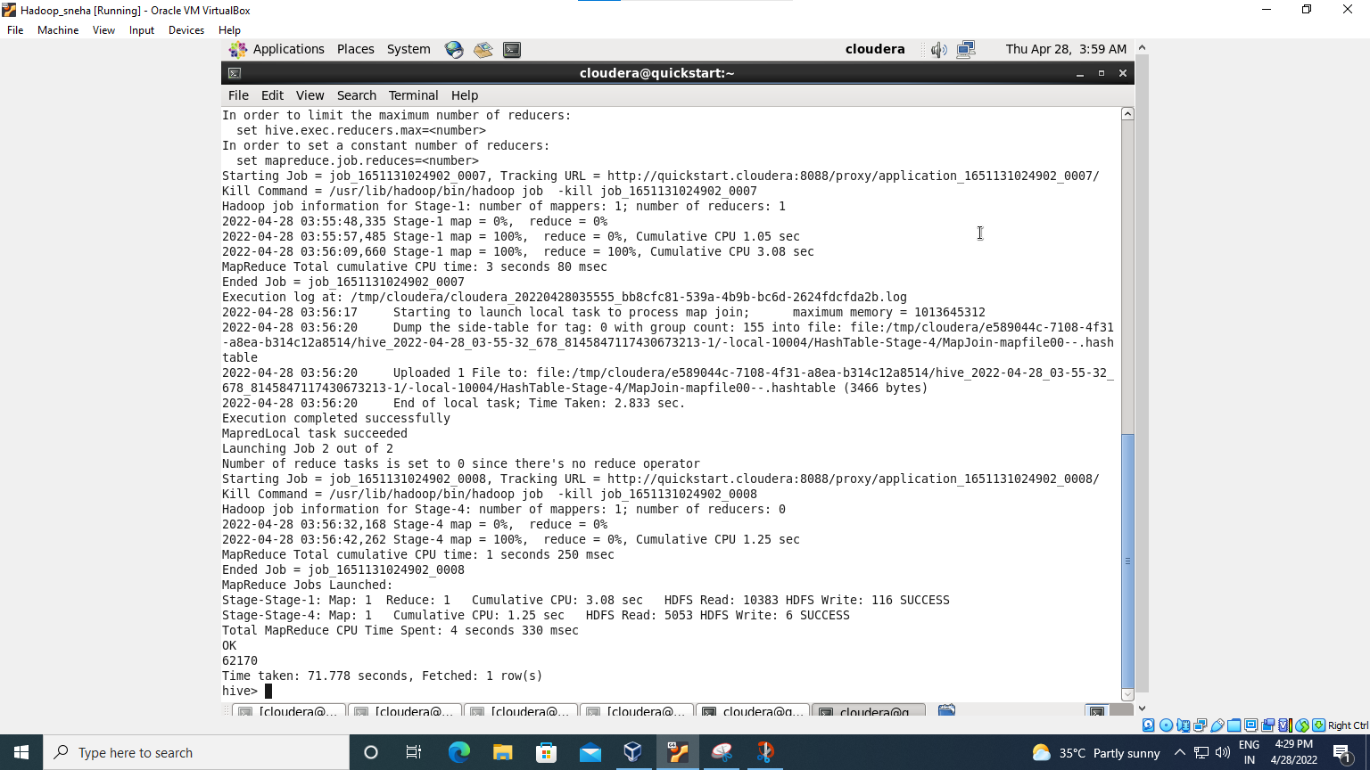
Output of Third Problem

Slide 15
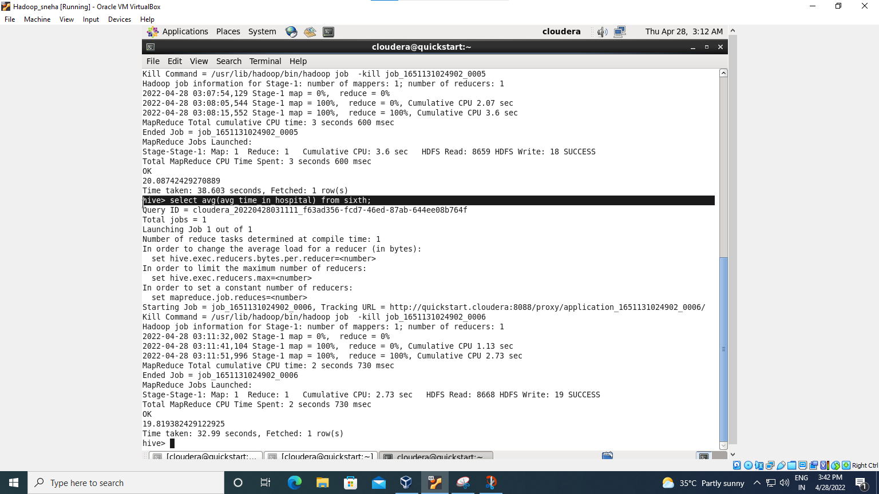
Output of Sixth Problem

Slide 16
Power bi
Features of visualizations are most understandable and effective in conveying information.
Since the graphic design of the mapping can adversely affect the readability of a chart, mapping is a core competency of Data visualization
A Power BI Dataset can work as a collection of data for use in Power BI reports, and can either be connected to or imported into a Power BI Report.
A Dataset can be connected to and get their source data through one or more Data flows.

Slide 17
Power bi process
Load the data in power bi in csv format
Set the data in the bi field
Expand the data to display all the columns
Choose the require data for visualisation
Convert the csv file into visualisation using bi tools
Export the data visualisation in required format
Make a report

Slide 18
Statement 02
Top 6 affected districts in India Improves planning and strategy to provide.
Need to upload data in power bi
Expanding the data in data field of power bi and using data to generate the visualisation we need to convert the csv format into visualisation
We used map as a visual for displaying top 6 affected districts
Filter on this visual used confirmed cases is greater the 67423
And made a clear report of that visual

Slide 19
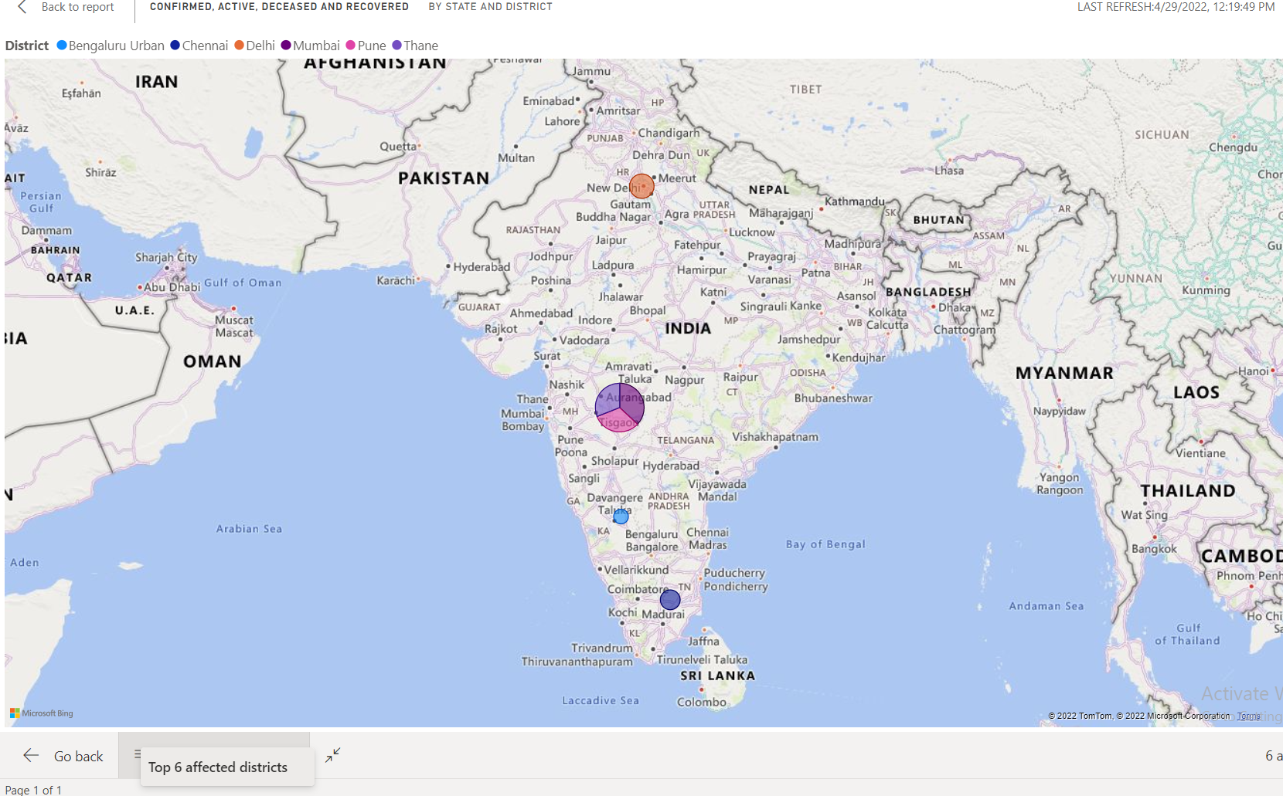
Statement 02 visualisation

Slide 20
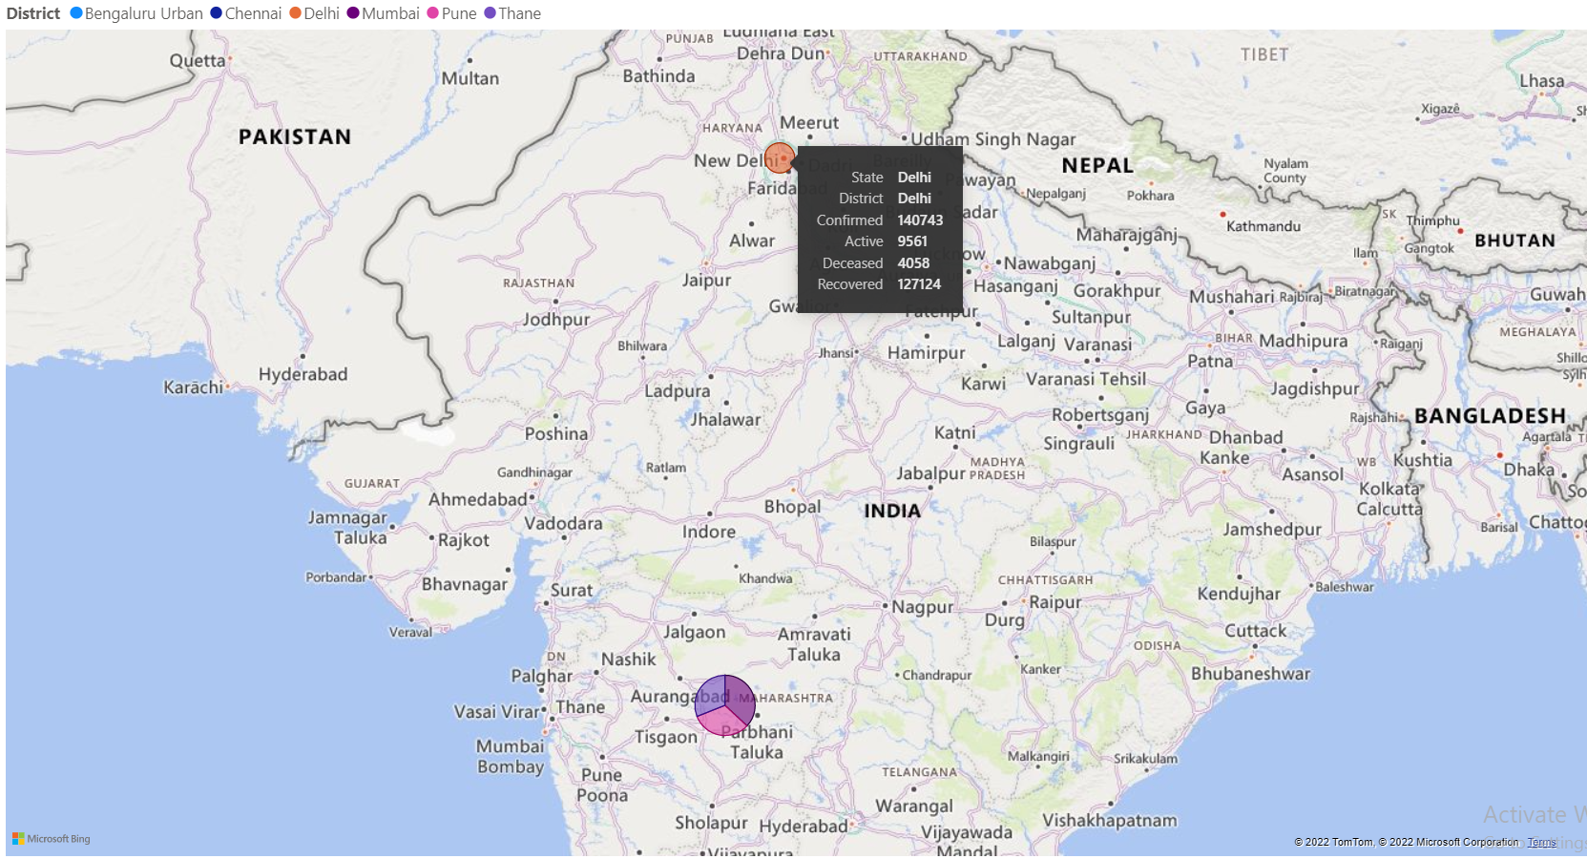
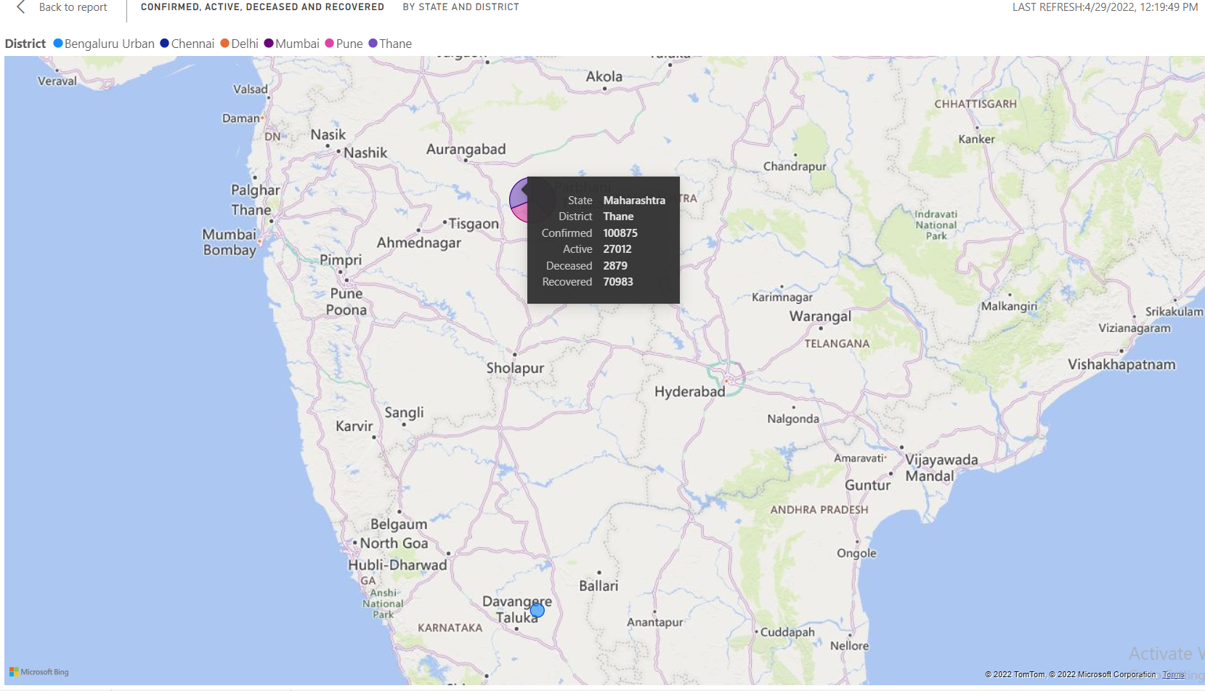
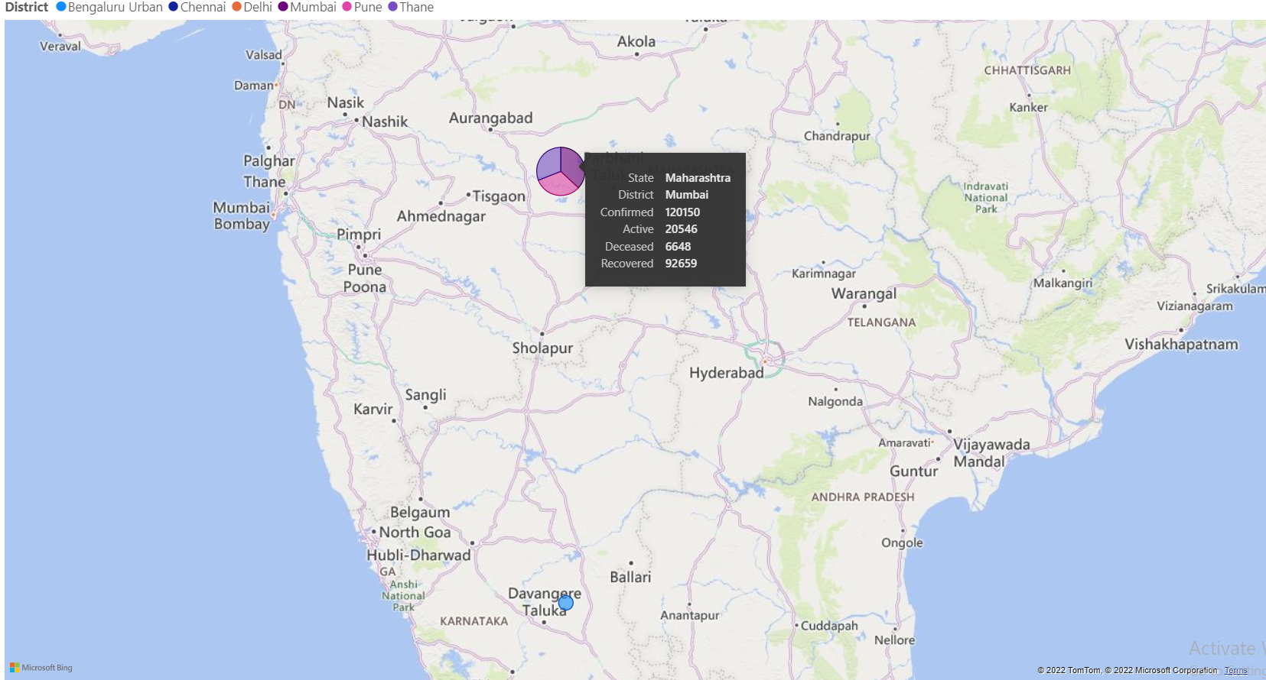

Slide 21
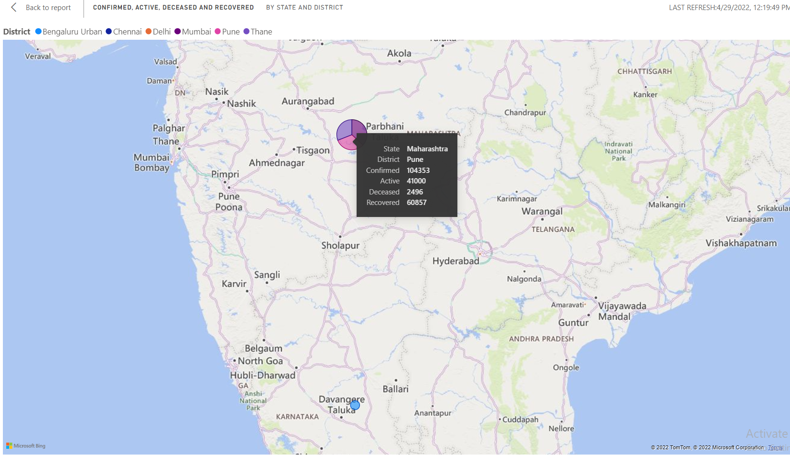
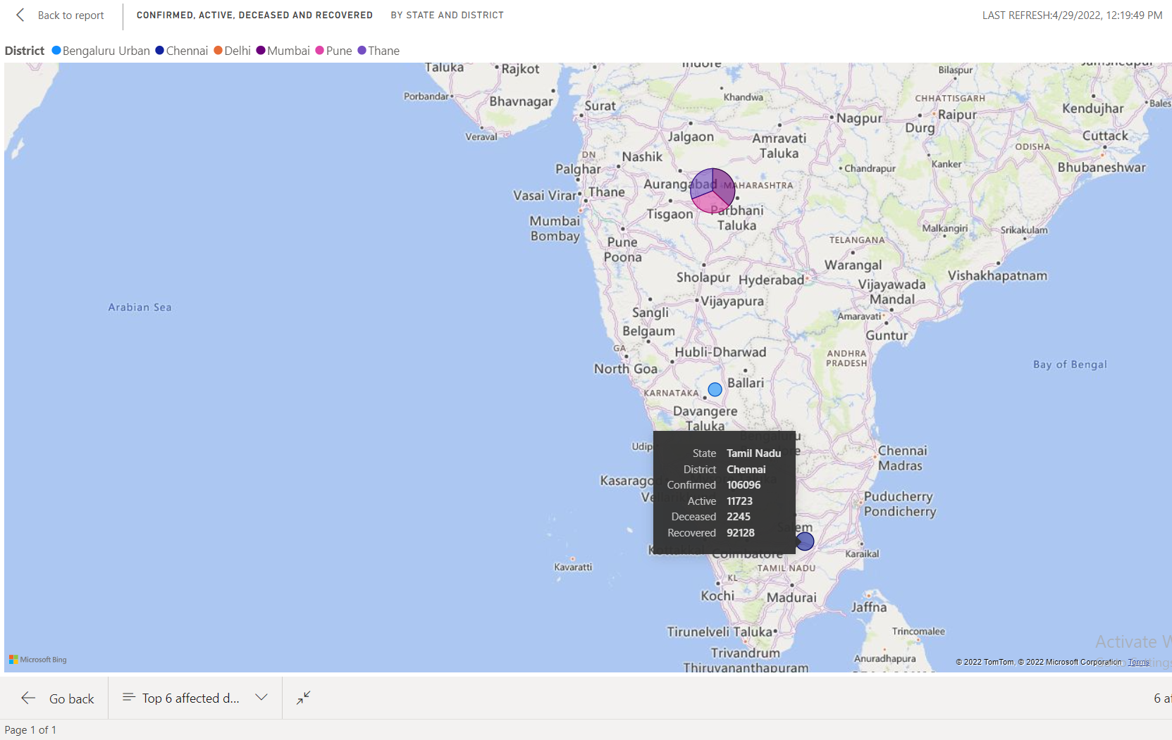
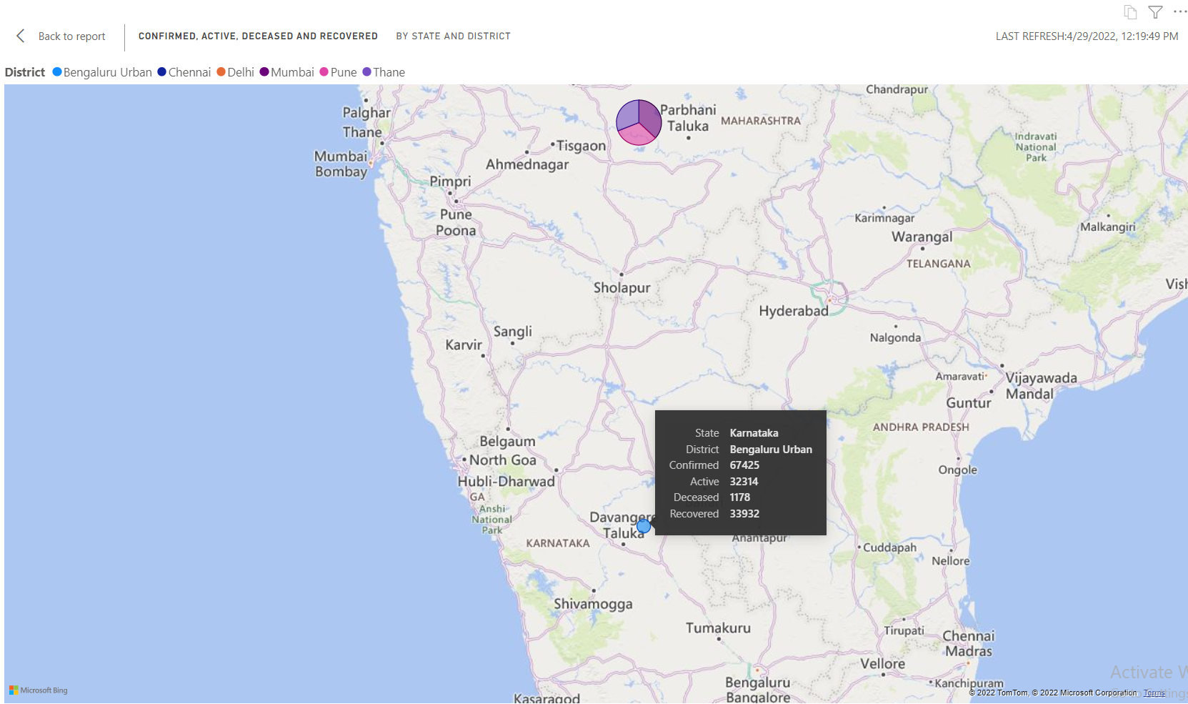

Slide 22
Statement 03
Patient demographics to understand the spread and trend in daily cases treatment.
Need to upload data in power bi
Expanding the data in data field of power bi and using data to generate the visualisation we need to convert the csv format into visualisation
We used Donut chart as a visual for displaying the patient demographics on daily based
Filter on this visual used sum of the number of cases in states
And made a clear report of that visual

Slide 23
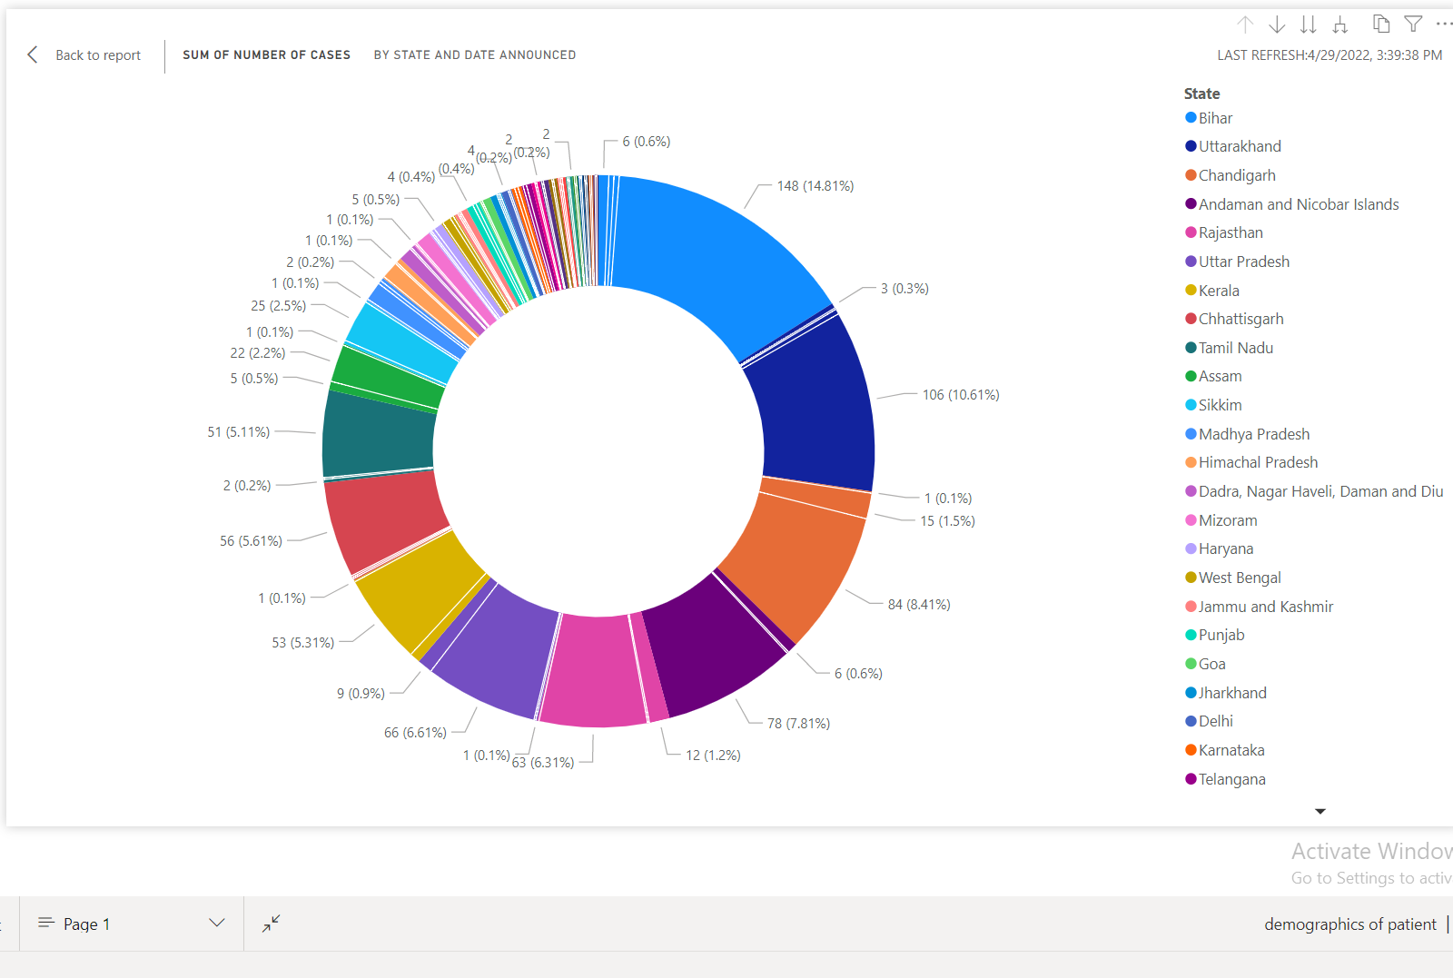
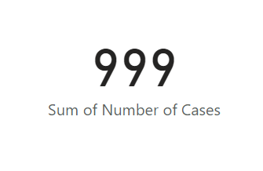
Statement 03 visualisation

Slide 24
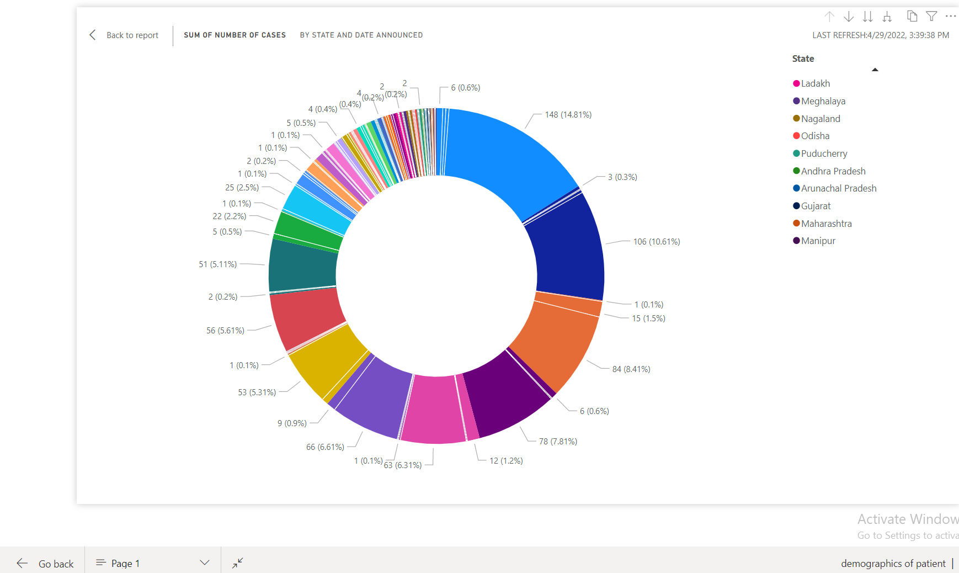
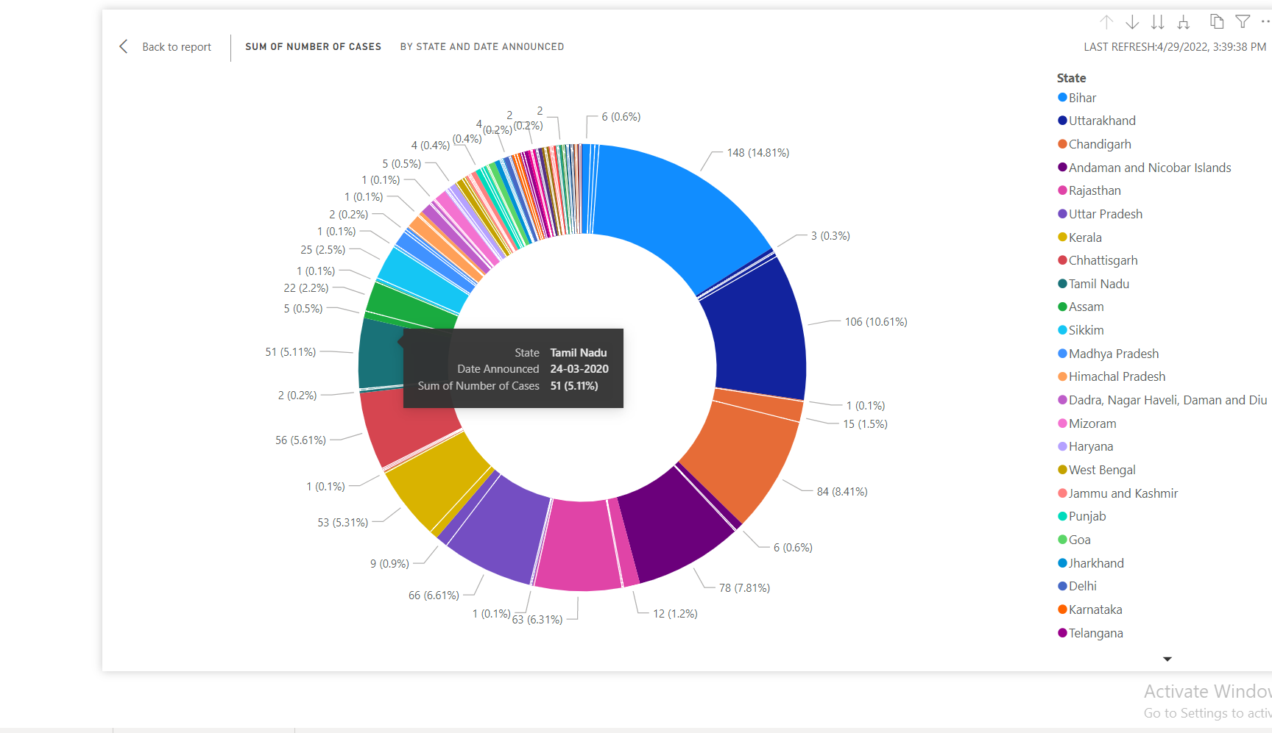
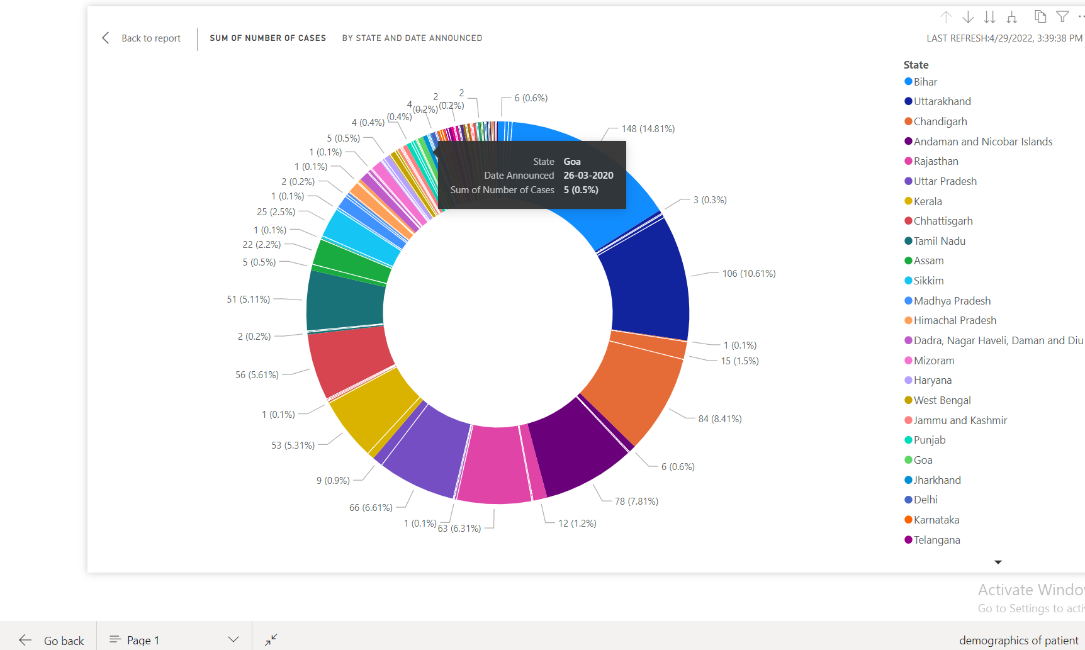
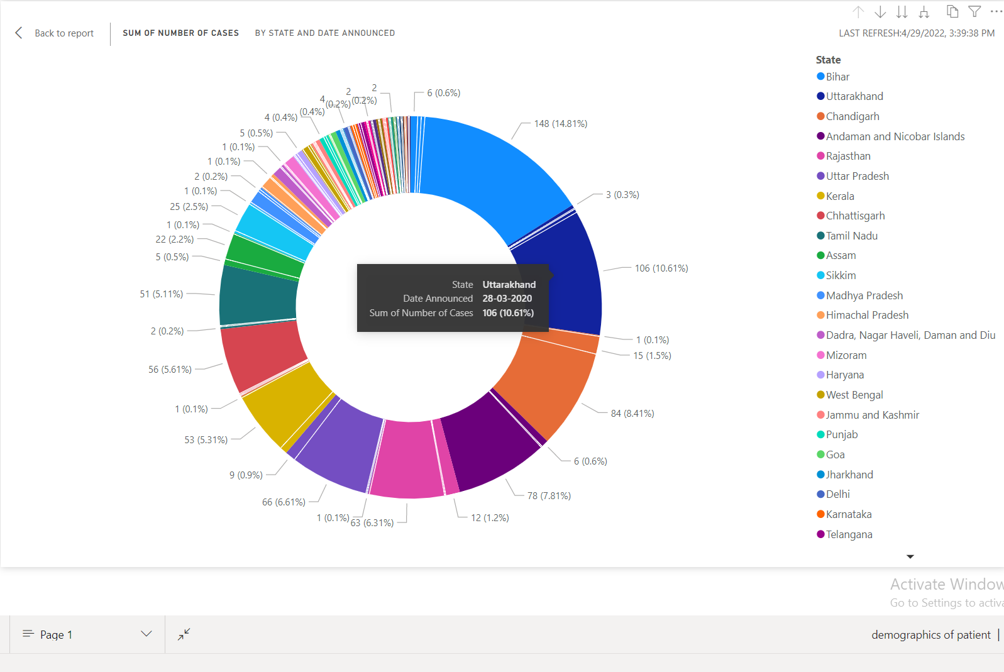

Slide 25
Statement 04
Provides Key insights for new policy formation like lockdown extension.
Need to upload data in power bi
Expanding the data in data field of power bi and using data to generate the visualisation we need to convert the csv format into visualisation
We used data table and converted that table into a visualisation and picked the key insights of that data
And made a clear report of that visual

Slide 26
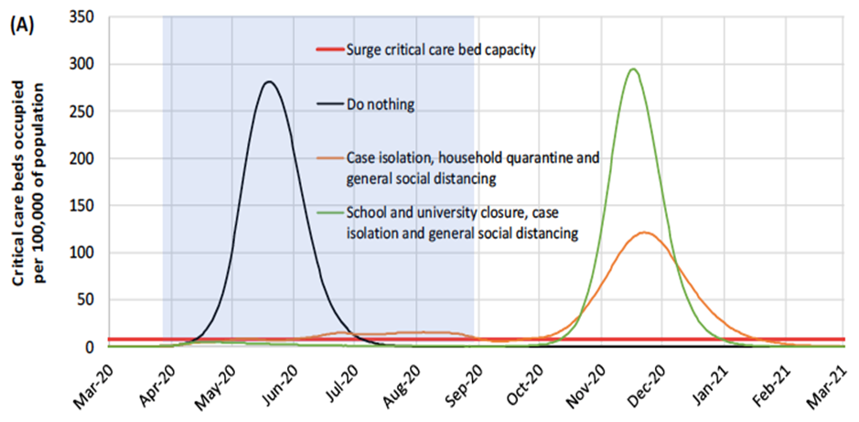
Statement 04 visualisation

Slide 27
Key insights for new policy formation like lockdown extension.
India had already been experiencing a prolonged economic slowdown. The GDP growth rate had fallen from 8.2% in January-March 2018 to 3.1% in January-March 2020.
It obtained that Lockdown has been shown to be related to human psychology. It was determined that stress (8.0%) and depression (16.0–28.0%) were psychological reactions during the COVID-19 pandemic.
In 2021 ,due to the largest wave of infection in the country, several state governments like uttar pradesh,delhi etc. have announced complete lockdowns in april 2021

Slide 28
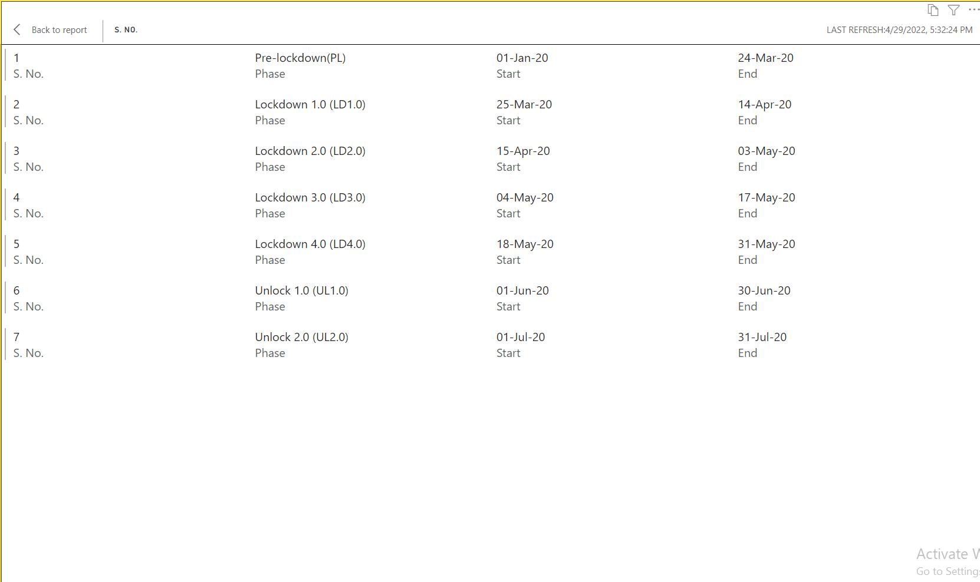
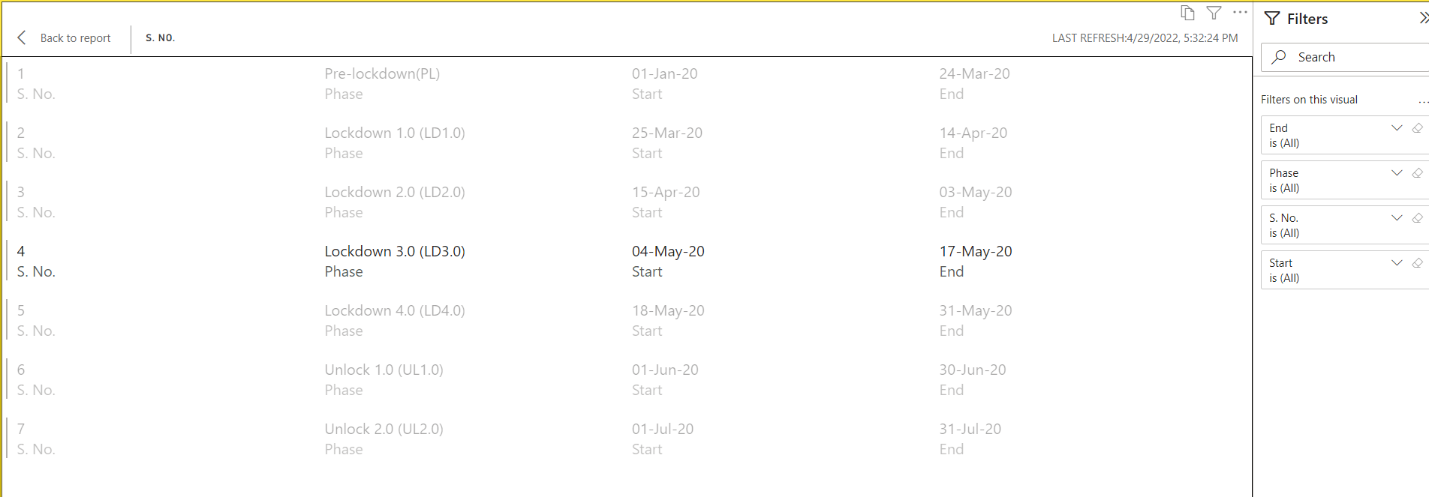
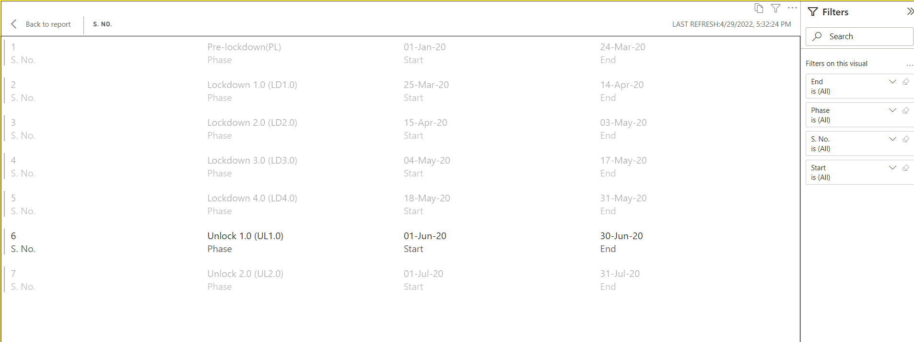

Slide 29
Statement 05
Predicts the saturation point for the spread
Need to upload data in power bi
Expanding the data in data field of power bi and using data to generate the visualisation we need to convert the csv format into visualisation
We used Line chart as a visual to predict the saturation point for the spread
And made a clear report of that visual

Slide 30
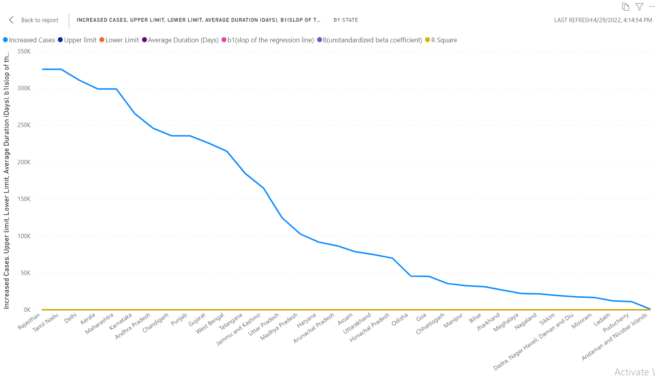
Statement 05 visualisation

Slide 31
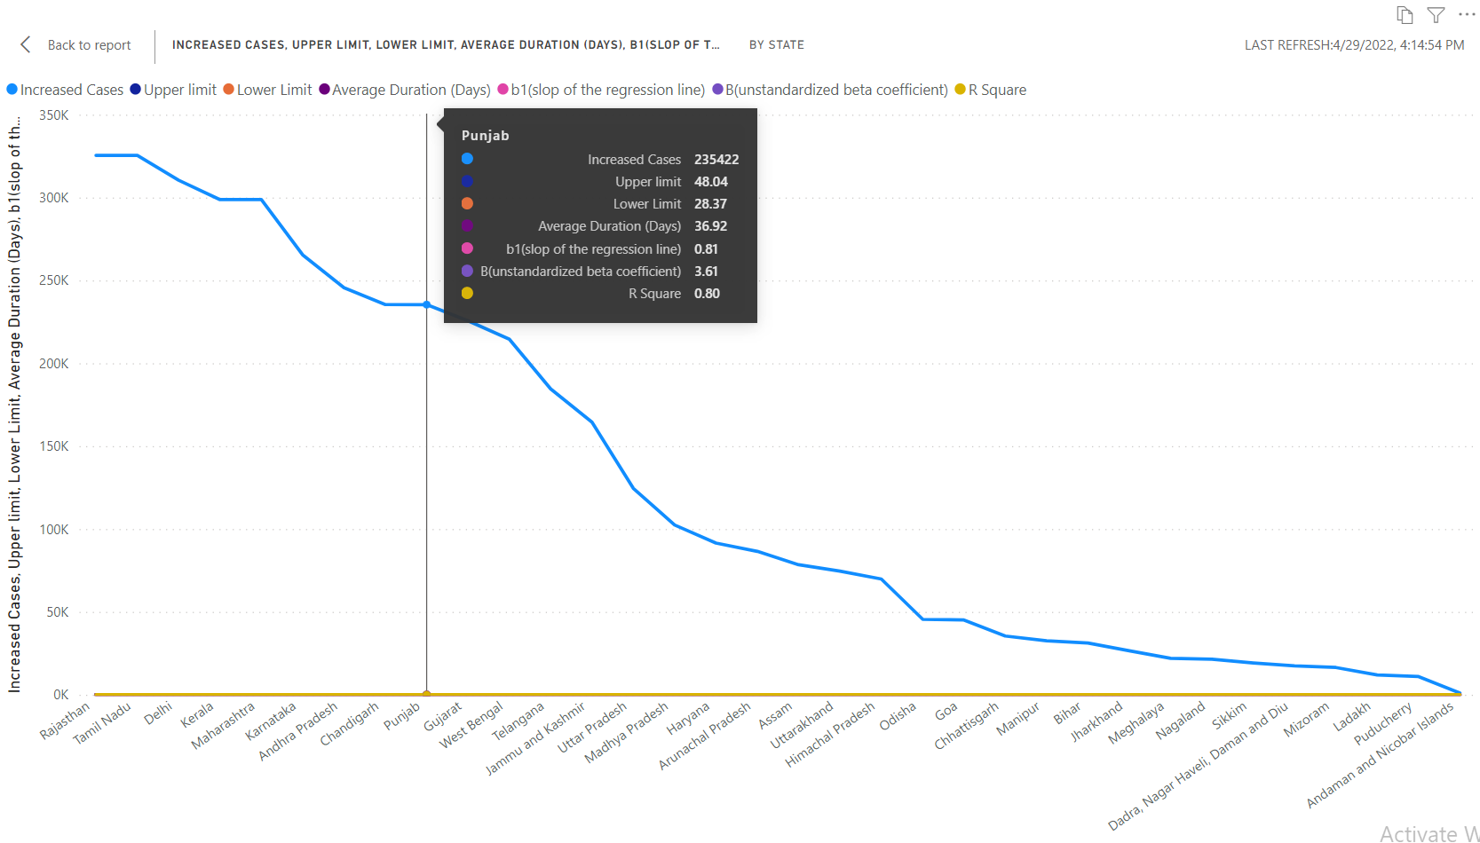
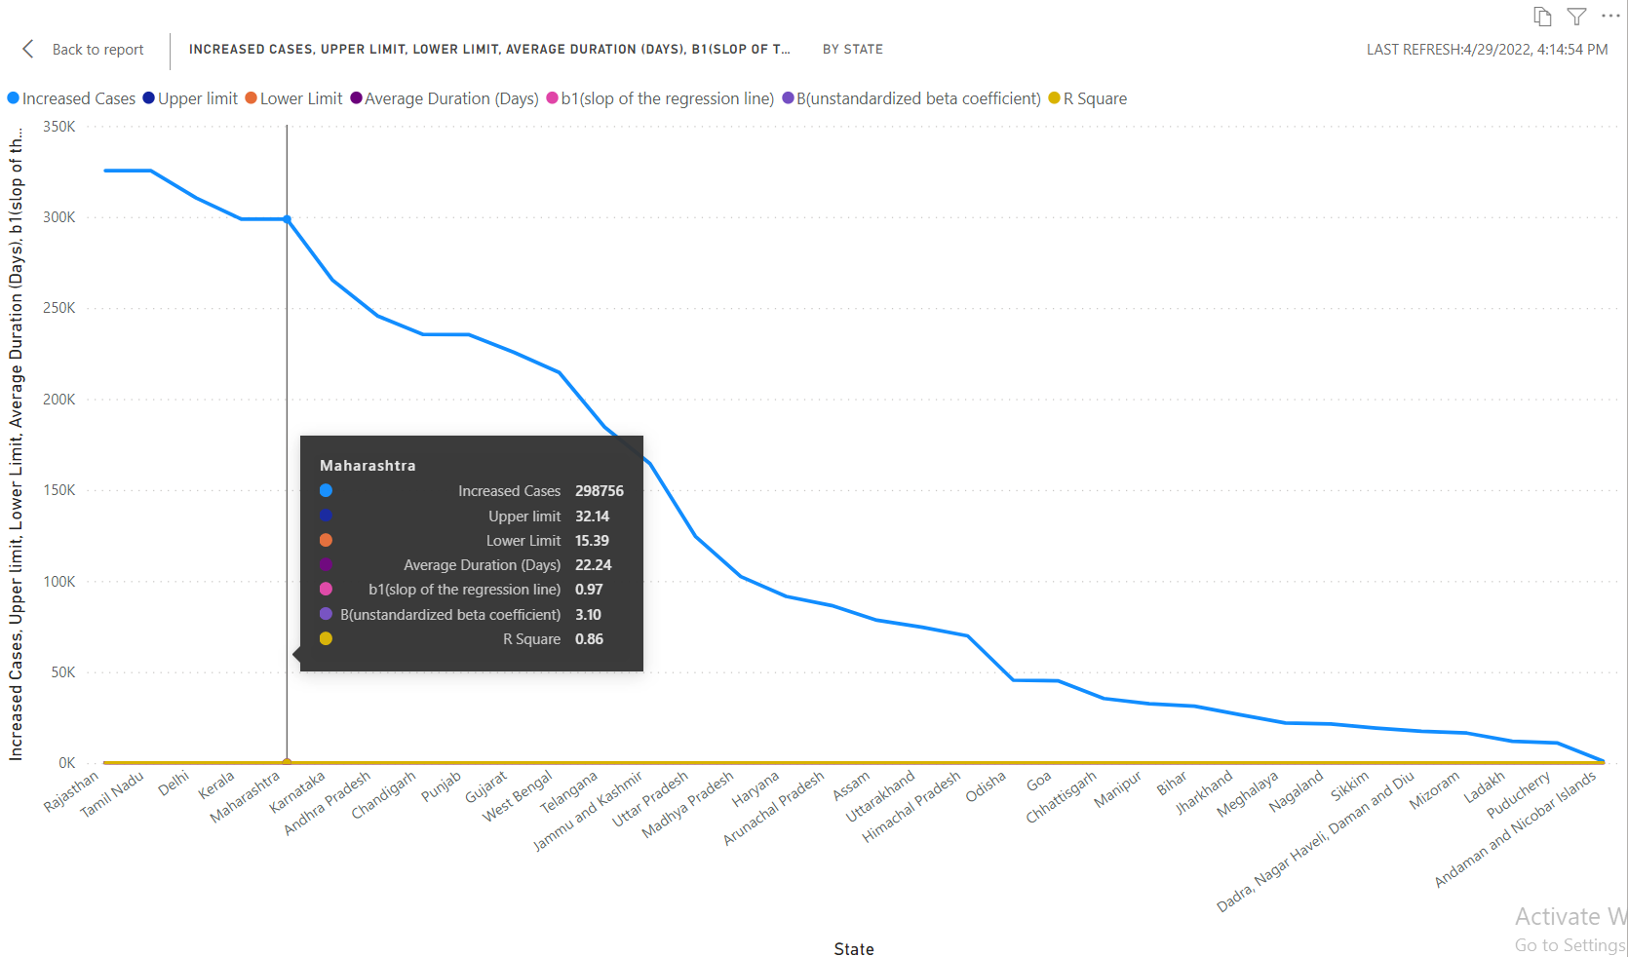
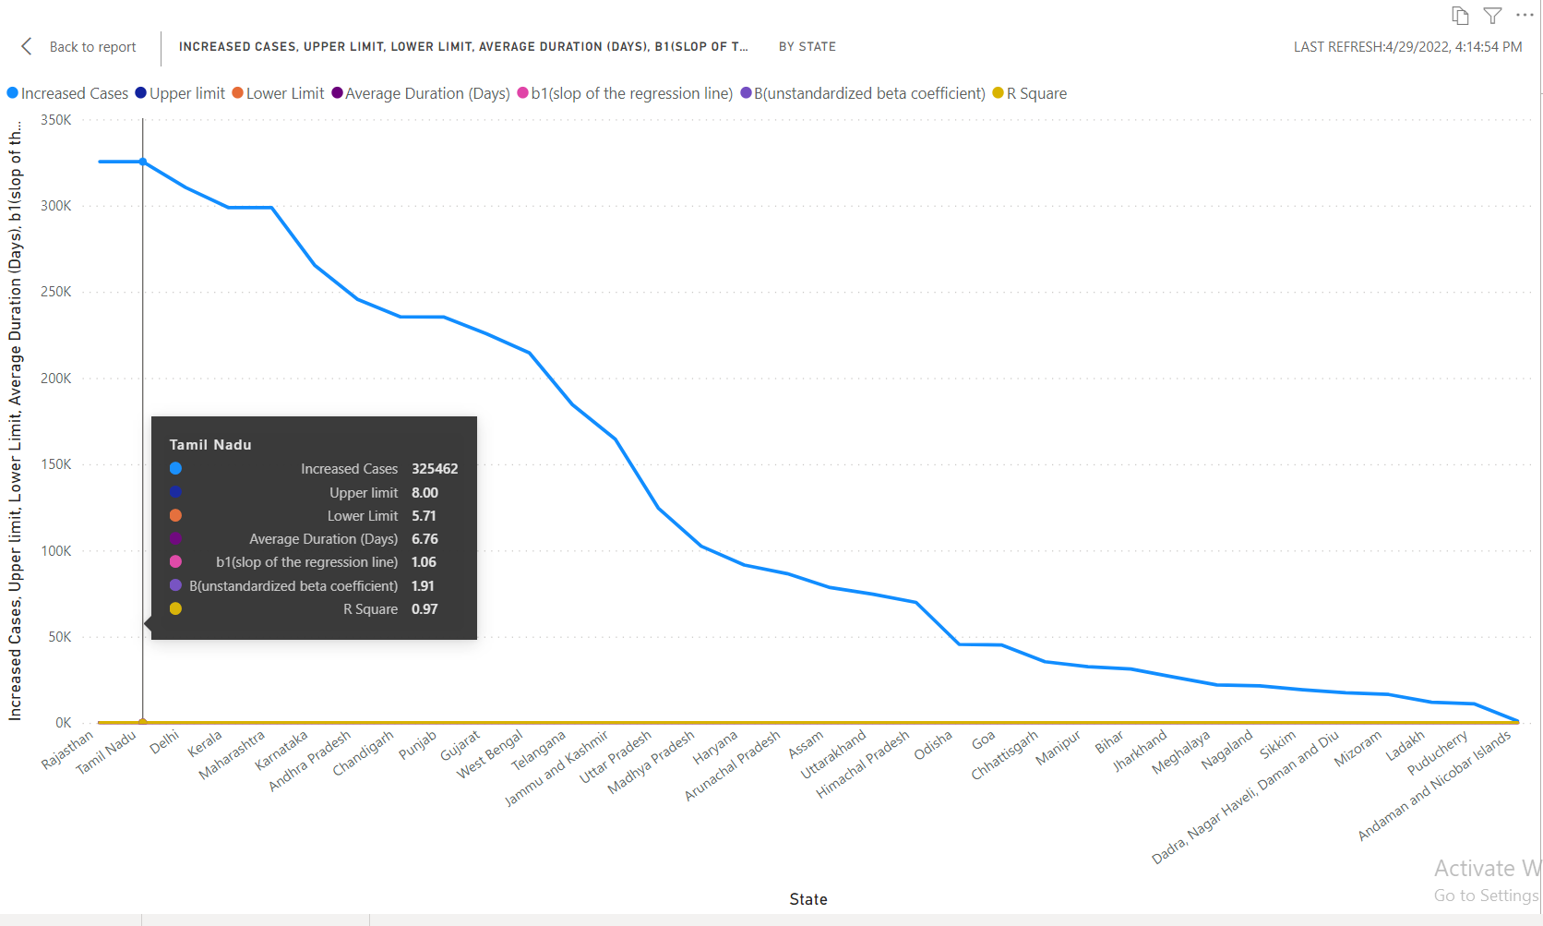
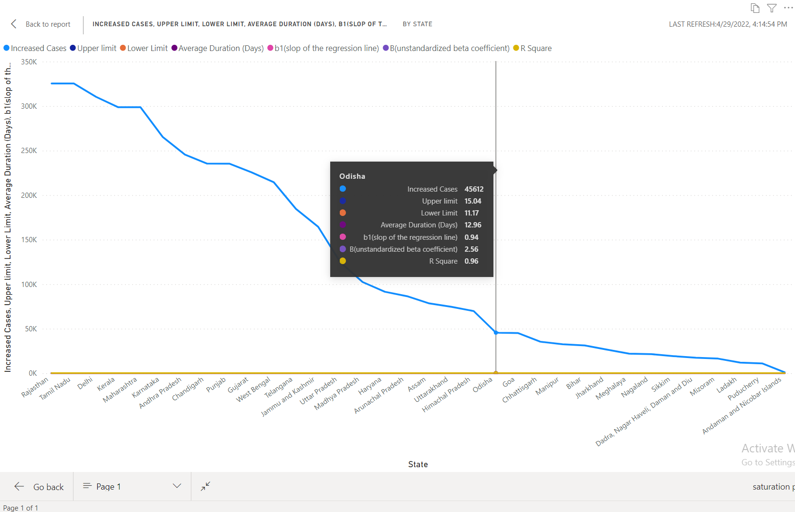

Slide 32
Statement 06
Average time taken by patients to recover, average time a patient stays in hospital
Need to upload data in power bi
Expanding the data in data field of power bi and using data to generate the visualisation we need to convert the csv format into visualisation
We used Area chart as a visual to display the Average time taken by patients to recover, average time a patient stays in hospital
Filter on this visual we selected all data
And made a clear report of that visual

Slide 33
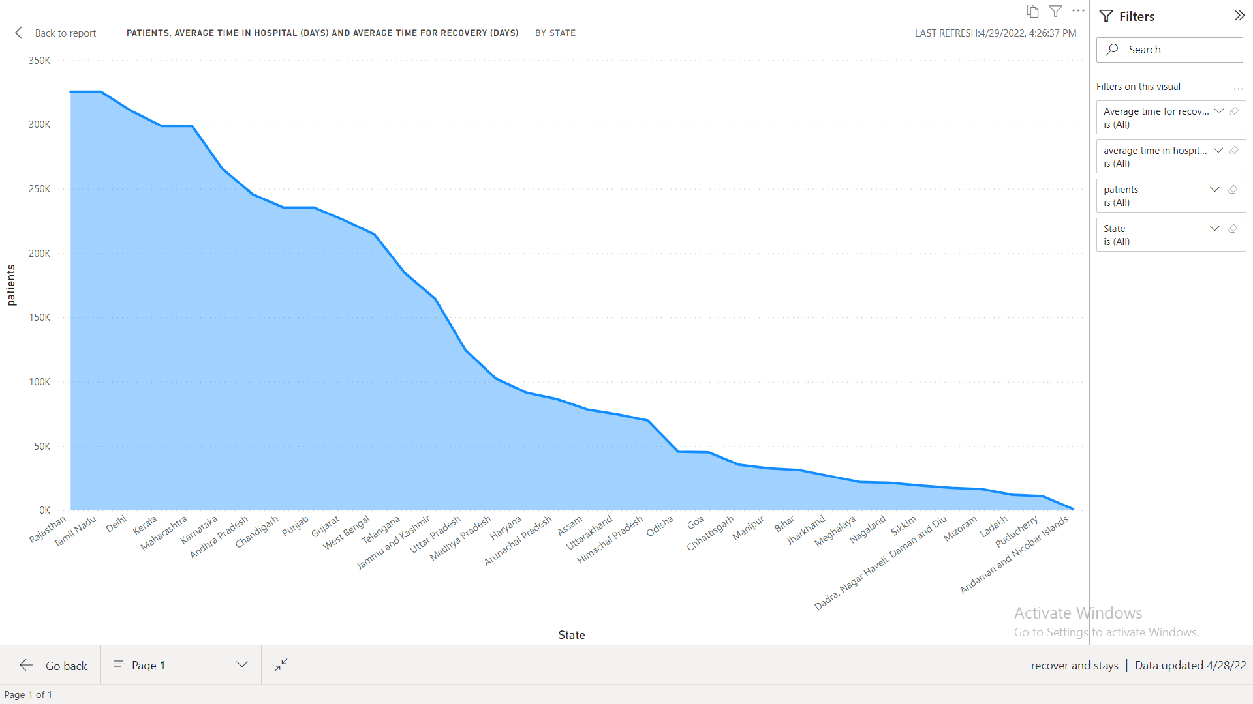
Statement 06 visualisation

Slide 34
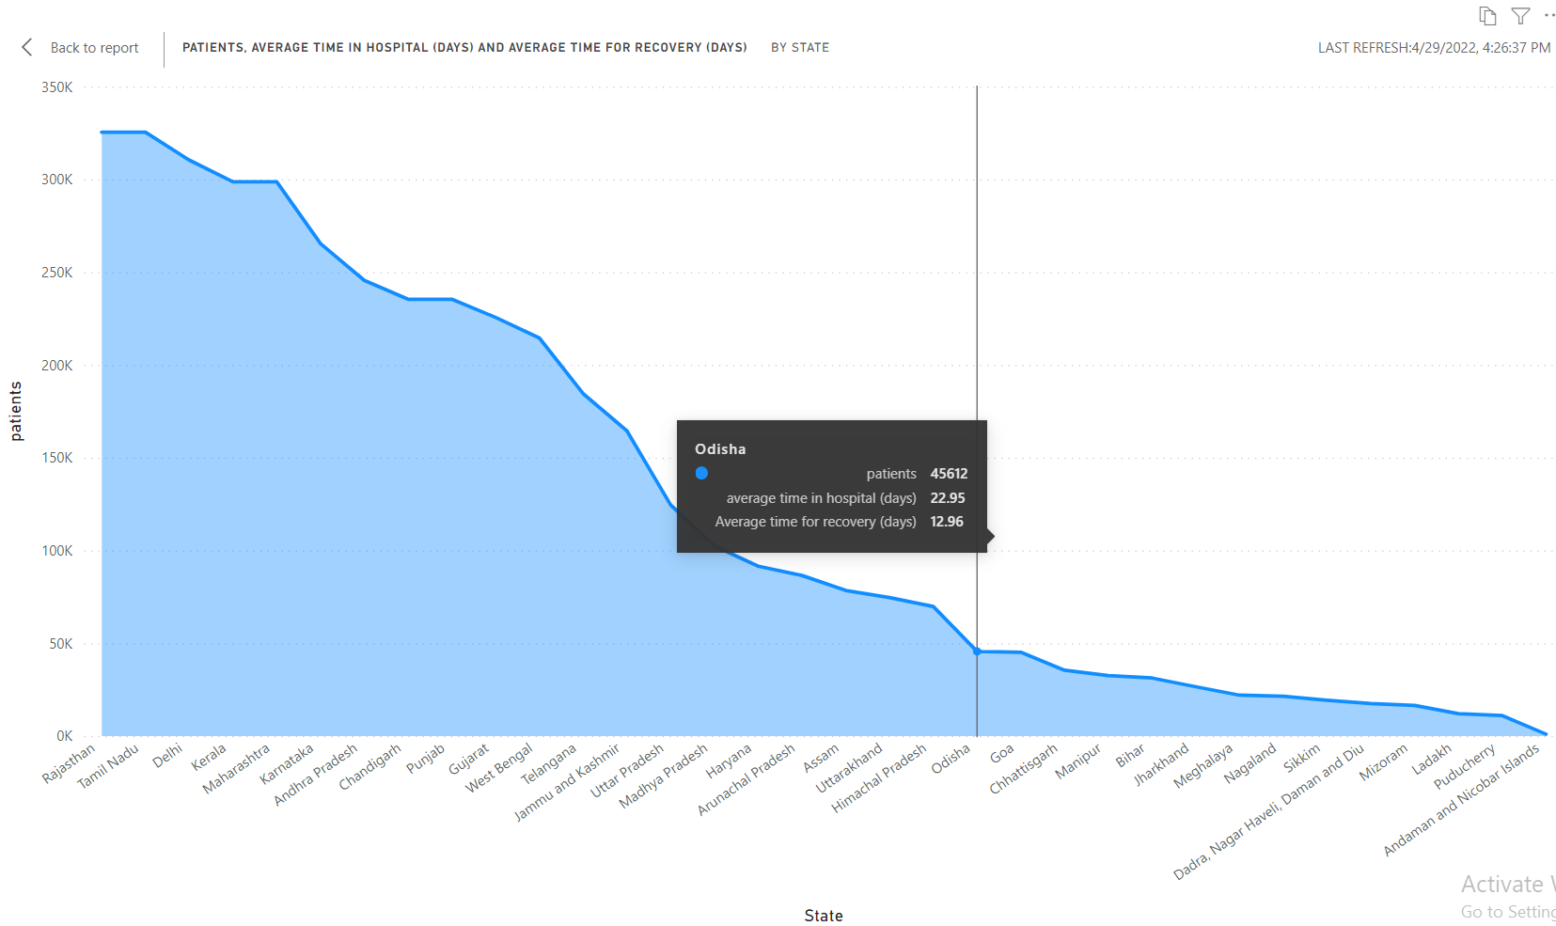
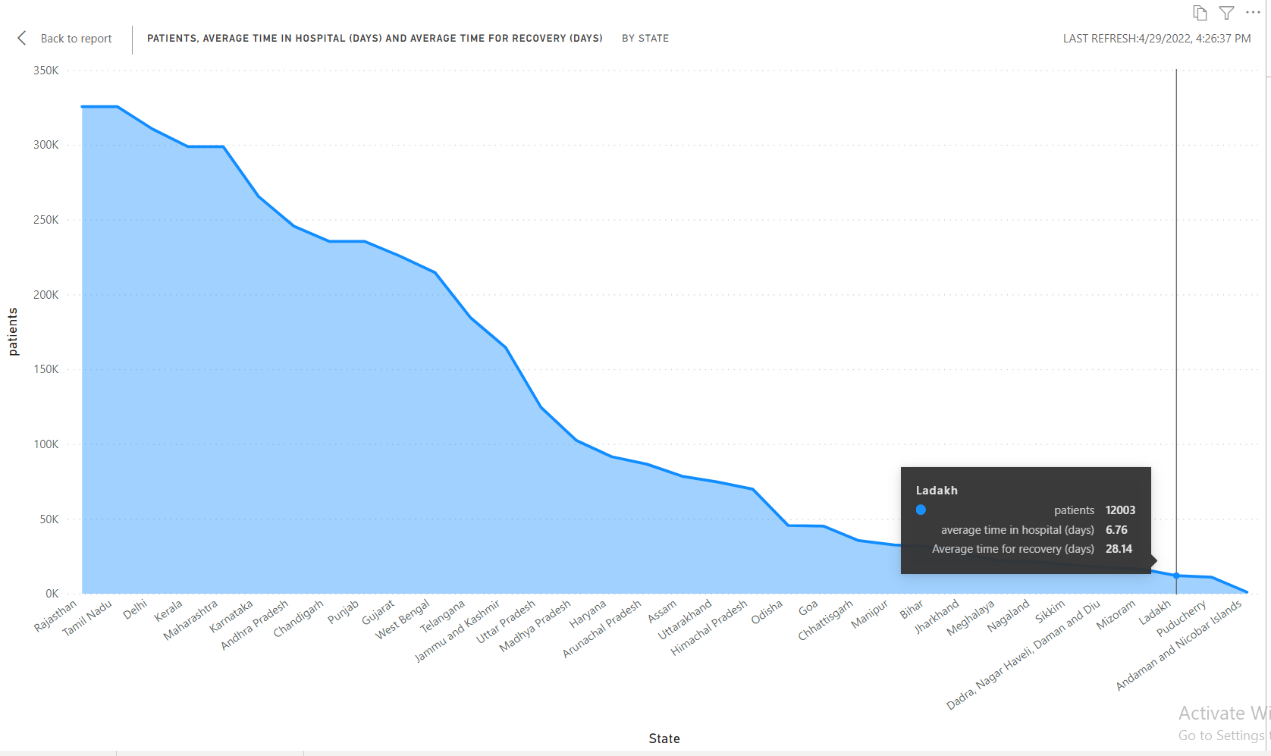
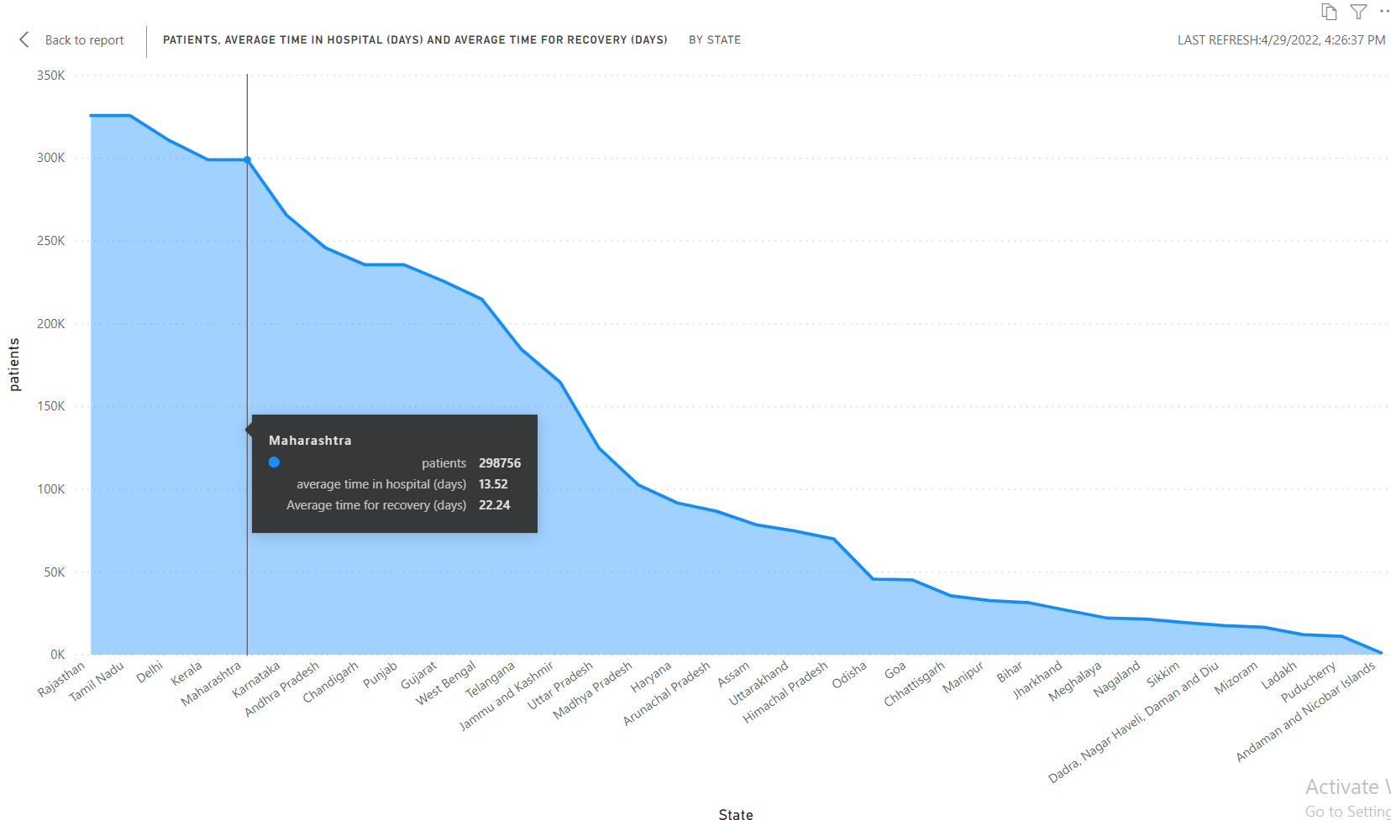
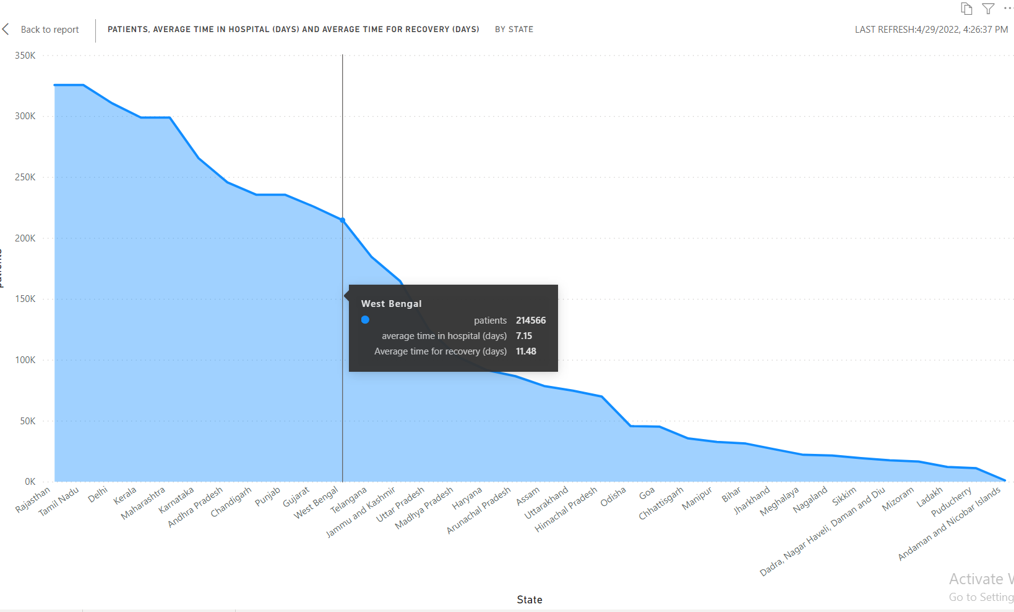

Slide 35
Statement 07
To track load on healthcare facility and predict number of ventilators required in future.
Need to upload data in power bi
Expanding the data in data field of power bi and using data to generate the visualisation we need to convert the csv format into visualisation
We used Pie chart as a visual to display the track load on healthcare facility and predict number of ventilators required in future.
Need to display for how many people 1 ventilator catering to
Filter on this visual we selected all data
And made a clear report of that visual

Slide 36
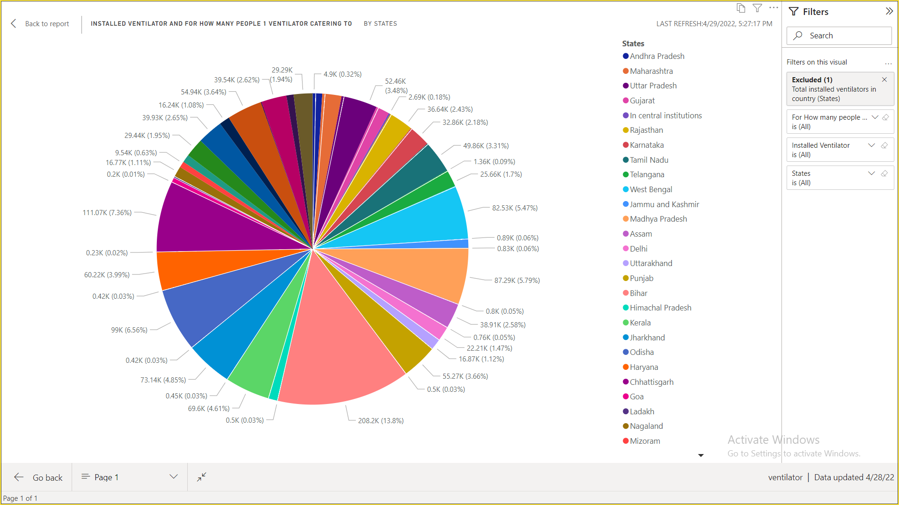
Statement 07 visualisation

Slide 37
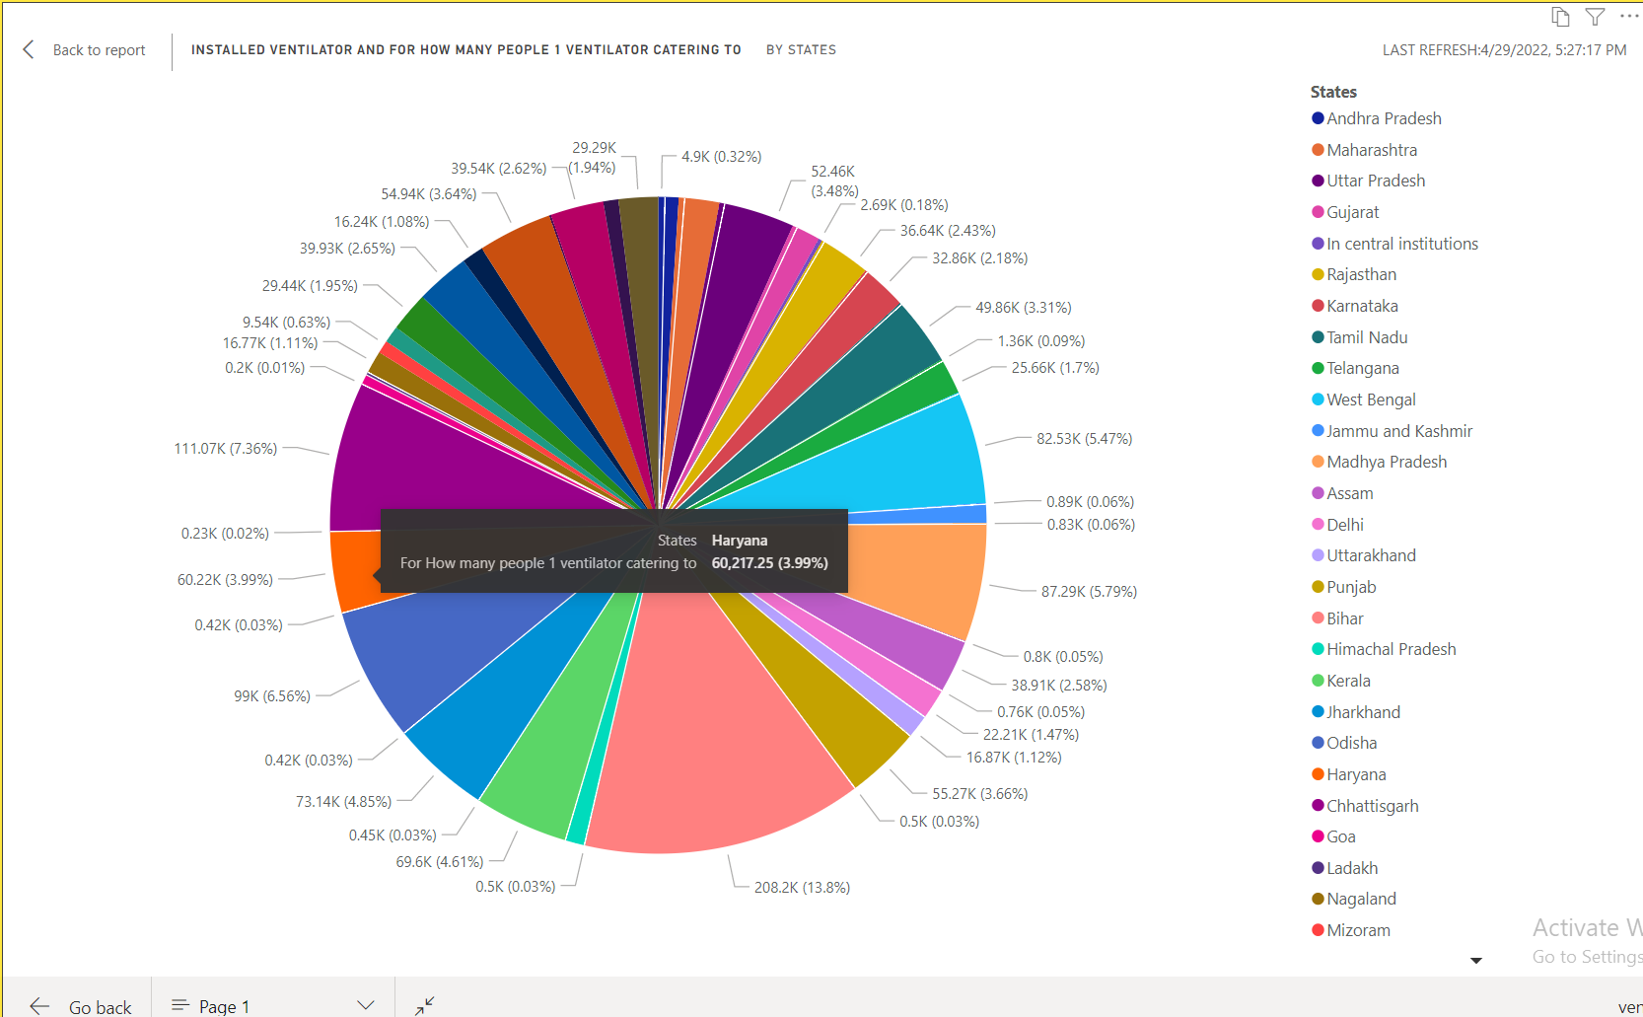
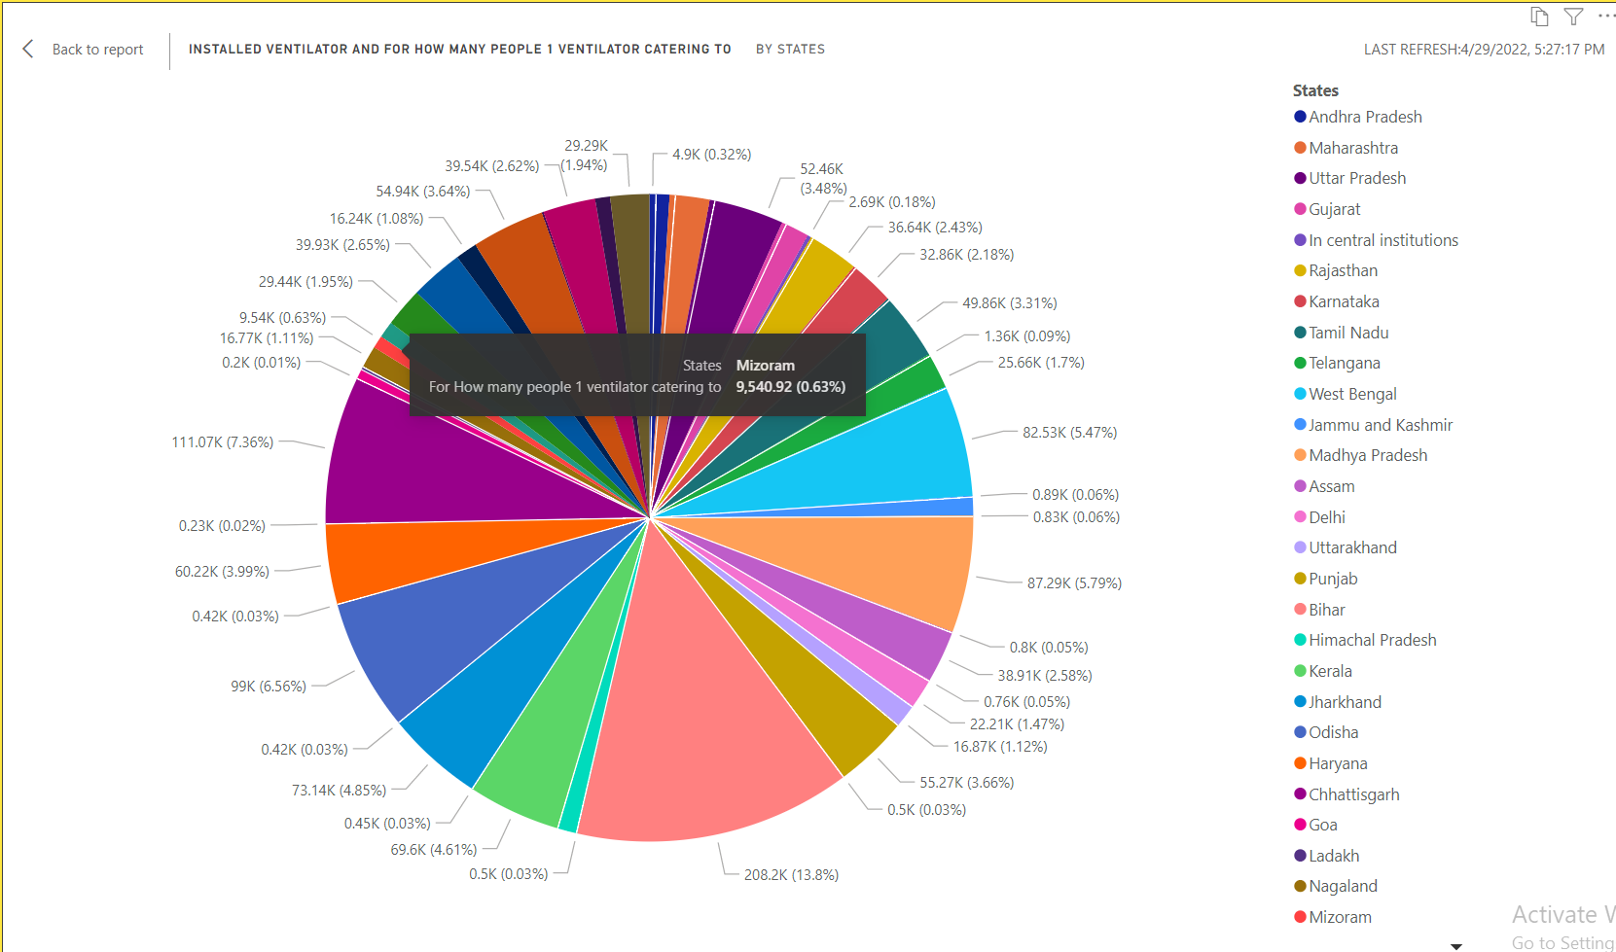
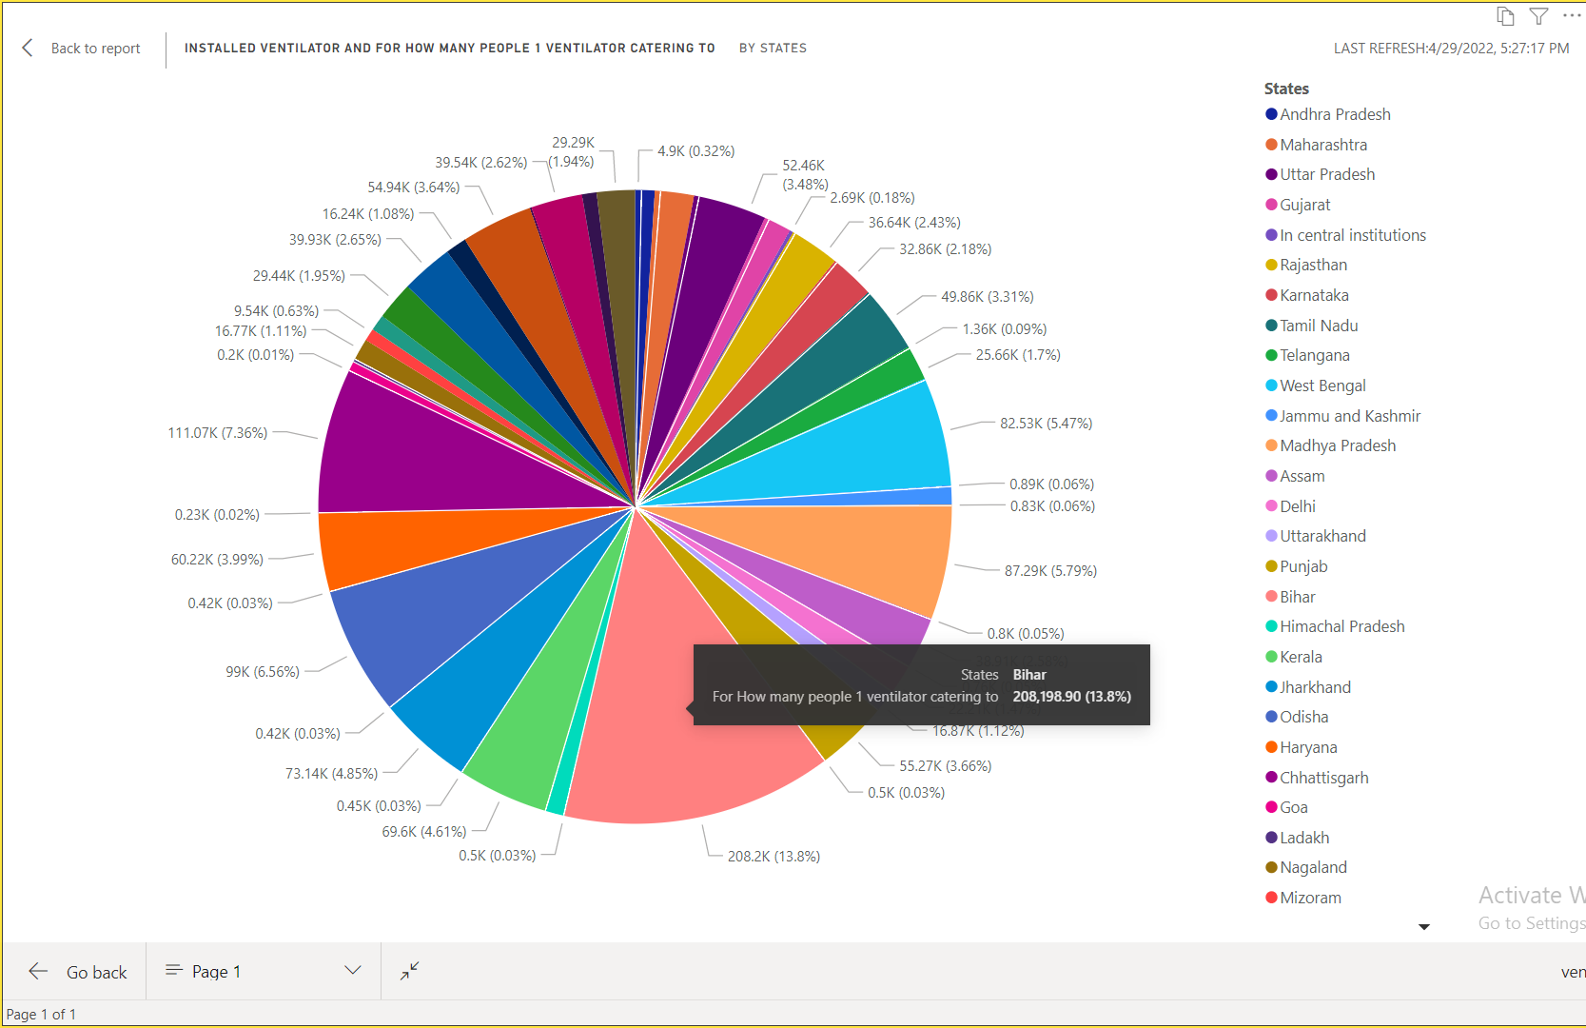
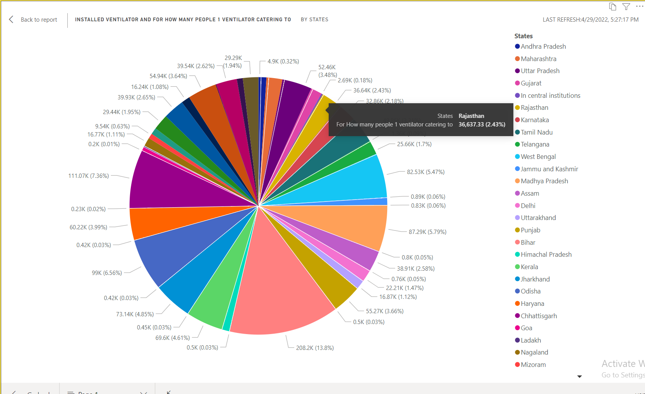

Slide 38
CONCLUSION
The volume of data increases dramatically over time, especially data generated on the global pandemic caused by COVID-19. Such volume of data requires utilizing big data analytics tools along with BI tool to make sense of the pandemic and its spread in a timely manner.
In this study, we presented a review of several data analysis applications for COVID-19 to find key insights on patient demographics, patient clusters, state and district level spread and also to find transmission rate, top affected districts and predict the saturation point of the disease spread .Finally, we highlighted and discussed about track load on healthcare facility and predict number of ventilators required in future.

Slide 39
Thank You

